Slide 1
Vrinda Store Annual sales Report

Slide 2

Objective/Problem Statement
Vrinda store wants to create an annual sales report for 2023. so that ,Vrinda can understand their customers and grow more sales in 2024

Slide 3
Questions
Compare the sales and orders using single chart.
Which month got the highest sales and orders?
Who purchased more men or women in 2023?
What are different orders status in 2023?
List top 10 states contributing to the sales?
Relation between age and gender based on number of orders
Which channel is contribution to maximum sales?
Highest selling category?,etc.

Slide 4
Data Cleaning
Gender and QTY column was cleaned and set in the same format for better processing
Checked is there any null values in the data set or not.
Checked format and data types of all the column.

Slide 5
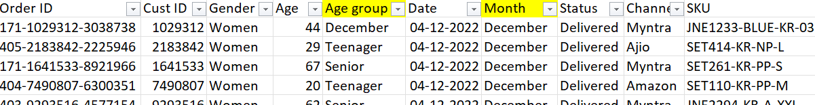
Data processing
Created a Age group Column and Month Column for better understanding and visualization .
Formula used for this is
=IF(E2>=50,"Senior",IF(E2>=30,"Adults","Teenager"))
=TEXT(G2,"mmmm")

Slide 6
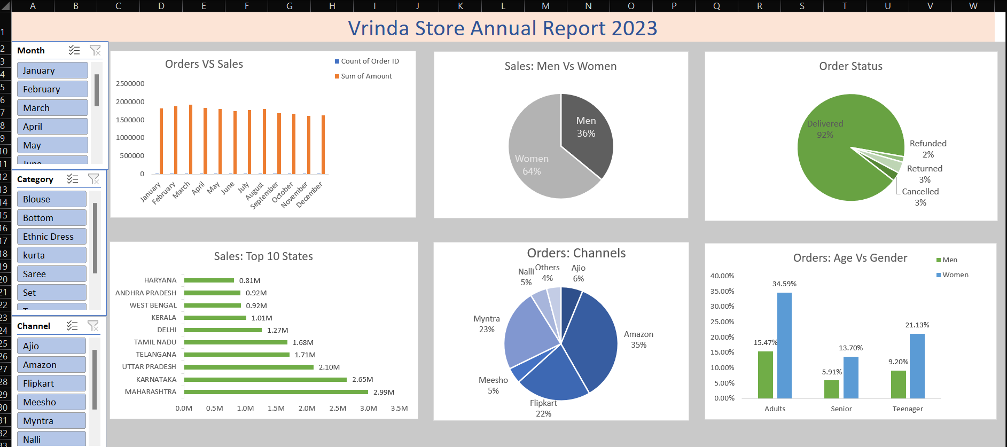
Data Analysis
Creating a pivot table and Dashboard according to the problems statements.

Slide 7
Sample Insights
Women are more likely to buy compared to men (~65%)
Maharashtra, Karnataka and Uttar Pradesh are the top 3 states (~35%)
Adult age group (30-49 yrs) is max contributing (~50%)
Amazon, Flipkart and Myntra channels are max contributing (~80%)
Final Conclusion to improve Vrinda stores sales:
Target women customers of age group 30-49 yrs living in Maharashtra, Karnataka and Uttar Pradesh by showing ads/offers/coupons available on Amazon, Flipkart and Myntra

